Slide 1
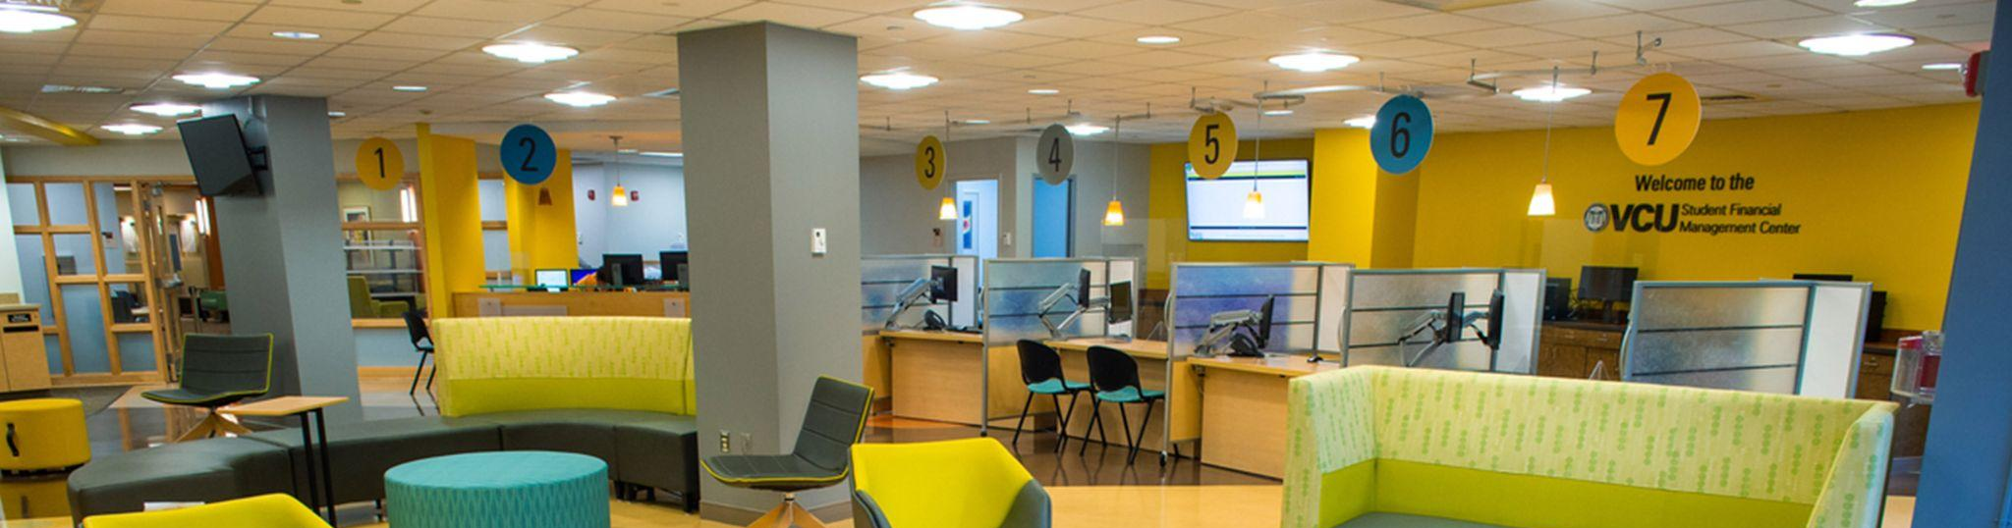
Understanding and Completing the 2026-2027 FAFSA

Slide 2
2026-2027 FAFSA Terminology
Account Username and Password (FSA ID): username and password used to log in to all Federal Student Aid products and tools on studentaid.gov.
Contributor: any individual required to provide consent and approval for federal tax information (FTI) along with their signature on the FAFSA form, including the student; the student’s spouse; a biological or adoptive parent; or the parent’s spouse (stepparent).
Primary or Custodial Parent: for a dependent student whose parents are divorced or separated, the primary or custodial parent is the parent who provides the greater portion of the student’s financial support and is required to provide their information (and if applicable their spouse’s information) on the FAFSA form.
Provisionally Independent Student: if a student indicates they have unusual circumstances or indicates for the first time they are unaccompanied and homeless, or at risk of being homeless (without a designation from a specified entity), the FAFSA will consider the student to be provisionally independent. The SAI will remain provisional and not official until the student’s college or career school makes a final determination. For special circumstances, please contact sfmc@vcu.edu.

Slide 3
2026-2027 FAFSA Completion on StudentAid.gov
VCU’s FAFSA School Code: 003735
VCU’s priority deadline this year is February 1st.
Students and parents need to create a FSA ID at Studentaid.gov. Effective August 2025, all users who create their FSA ID with a Social Security number (SSN) for the first time, will have their accounts verified immediately instead of the previous 1-3 business days waiting period. Individuals without SSNs will follow a different identity validation process that can take longer than 3 business days.
  If biological parents live in the same home and are either married or unmarried, both parents need a FSA ID.
  If biological parents are not together and the primary financial parent is remarried, both primary parent and stepparent need a FSA ID.
  If biological parents are not together and the primary financial parent is not married only the primary parent needs a FSA ID.
  If either contributor already has an existing FSA ID, do not attempt to create another. Follow steps to reset FSA ID username and/or password if you need to.

Slide 4
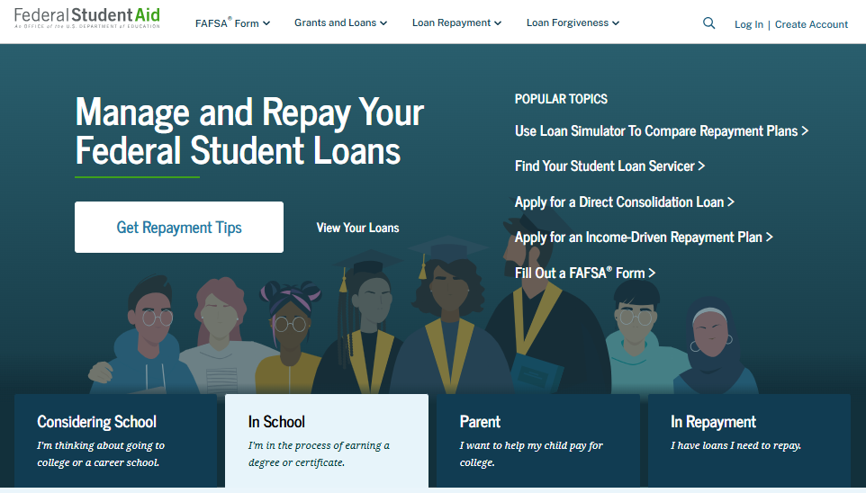

Slide 5
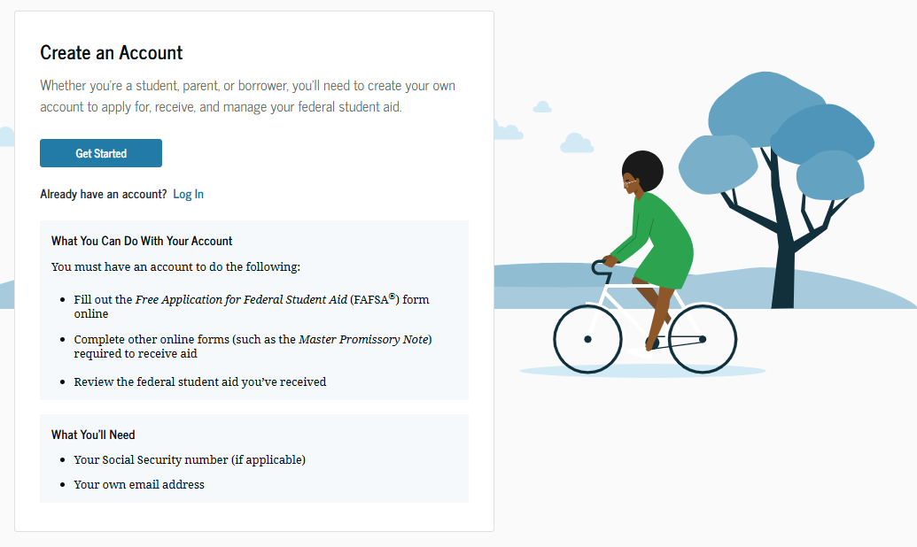

Slide 6
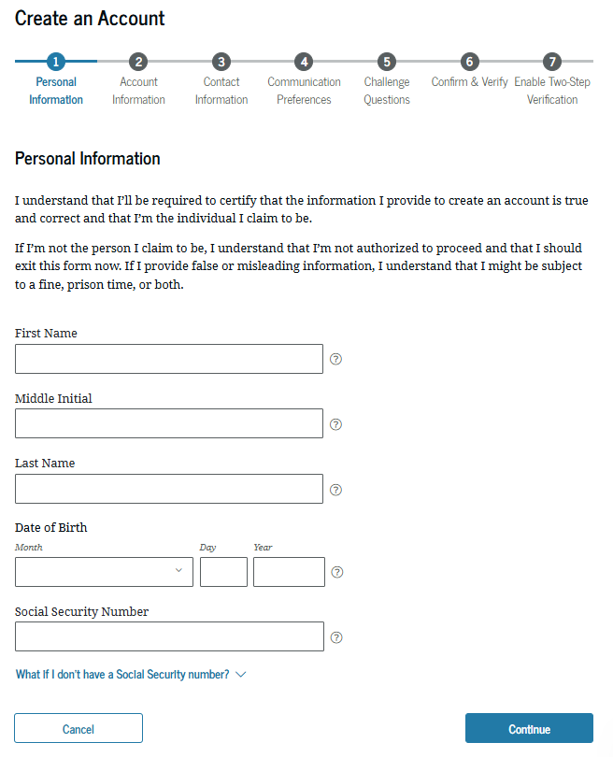

Slide 8
Federal Tax Information Consent
Each student will be required to provide consent and approval for Federal Student Aid (FSA) to access their Federal Tax Information (FTI) and upload it to their FAFSA, along with their signature on the FAFSA® form. If consent is denied, a pop-up will appear informing the student that without consent they will not be eligible for Federal Student Aid. The pop-up will look like this:
Summary
Your consent and approval are needed to retrieve and disclose federal tax information. With your consent and approval, we can obtain tax return information automatically from the IRS to help you complete your FAFSA form. If you don’t provide consent and approval, you will not be eligible for federal student aid, including grants and loans. You must provide consent and approval even if you didn’t file a U.S federal tax return or any tax return.
Get your 2024 tax return information for 2026-2027 FAFSA form
Tax return information is required to complete the FAFSA
Federal Tax information is used to determine your eligibility for federal student aid.

Slide 9
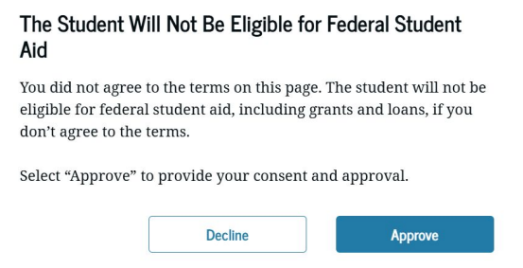
Federal Tax Information Consent
If the student does not give consent, the following pop-up will appear and they will be given the opportunity to provide consent.

Slide 10
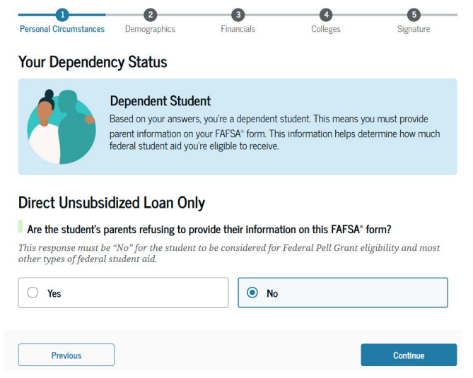
2026-2027 FAFSA Completion on StudentAid.gov
The student must begin the FAFSA form first. Once they invite their parent(s), they should continue to finish their portion of the FAFSA and sign it before the parent begins their portion of the FAFSA.
Many get confused by this question →
In order for a student to invite their parents, the proper answer to this question is “No.”
If the student answers “Yes” it pushes them through without giving them an option to invite their parent(s).

Slide 11
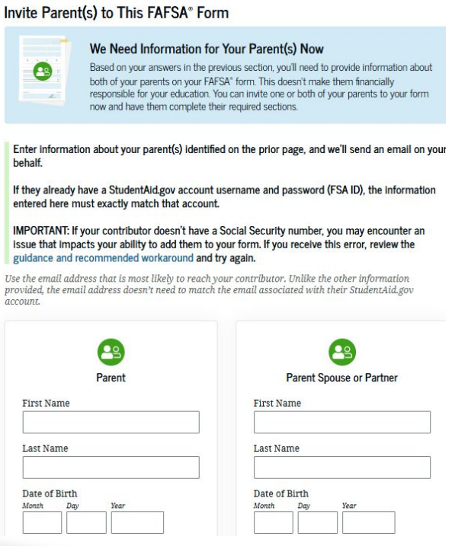
What is a Parent?
A biological or adoptive parent and/or the parent’s spouse (i.e. stepparent).
If your caretaker does not fit the above definition: answer FAFSA questions appropriately and email sfmc@vcu.edu to learn more.
The student HAS to invite their parent(s) to complete the FAFSA by way of the email address supplied by the student (does not have to be the parent email address associated with the parent’s FSA ID).

Slide 12
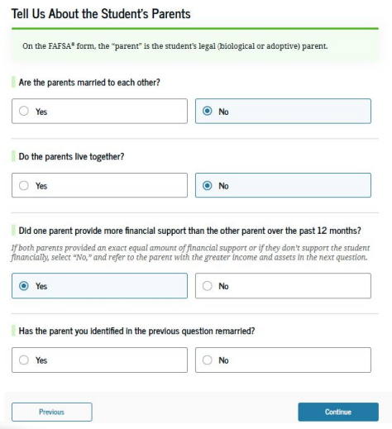
Which Parent?
Primary or Custodial Parent: for a dependent student whose parents are divorced or separated, the primary or custodial parent is…
  the parent who provides the greater portion of the student’s financial support; and
  is required to provide their information (and if applicable their spouse’s information) on the FAFSA form.

Slide 13
Parental Consent?
Once the parent accepts the invite, they will be required to provide consent and approval for federal tax information (FTI) along with their signature on the FAFSA® form. If consent is denied, a pop-up will appear informing that the student will not be eligible for Federal Student Aid.
Provide Consent and Approval or the Student Won’t Be Eligible for Federal Student Aid
Summary
Your consent and approval are needed to retrieve and disclose federal tax information. With your consent and approval, we can obtain tax return information automatically from the IRS to help you complete your FAFSA form. If you don’t provide consent and approval, the student will not be eligible for federal student aid, including grants and loans. You must provide consent and approval even if you didn’t file a U.S federal tax return or any tax return.
Get your 2024 tax return information for 2026-2027 FAFSA form
Tax return information is required to complete the FAFSA
Federal Tax information is used to determine your eligibility for federal student aid.

Slide 14
What’s Next?
If you have already attempted to complete your FAFSA and received an error, contact the SFMC for assistance. Please see our contact information below!
VCU will begin to receive completed 2026-2027 FAFSAs from the Department of Education mid November 2025.
Financial aid packages are estimated to be completed by the end of February for newly accepted students.
Virtually
Website: sfs.vcu.edu
Email: sfmc@vcu.edu
Drop-In Zoom Hours
Monday-Friday
9:00am-11:00am & 2:00pm-3:30pm
https://vcu.zoom.us/j/6739682425
In-Person
Office: Harris Hall, First Floor
1015 Floyd Avenue
Richmond, Virginia 23284
Monday - Friday
9:00 am - 5:00 pm

